Slide 1

Amigo: Smart Workflow Automation
Streamlining repetitive tasks efficiently with smart automation.
Suryansh Singh
Mrityunjay Pandey

Slide 2

Introduction: The Automation Imperative
Workflow Automation
Market Growth
Eliminates manual steps to save time and reduce errors.
$84B industry by 2027 with 12% annual growth.
Core Problem
Our Solution
Employees spend 20% time on repetitive tasks.
Amigo enables scalable, efficient workflows for any team.

Slide 3
Amigo: Concept and Core Features
Centralized Platform
Pre-built Connectors
Manage all workflows in one place easily.
Salesforce
Drag-and-Drop Interface
Slack
Google Workspace
Create workflows visually without coding.
Real-Time Monitoring
Track workflow status with detailed dashboards.
Example: Automates invoice processing, cutting cycle time by 60%.

Slide 4
Implementation: Under the Hood
Microservices Architecture
Python & Celery
Ensures scalability and system resilience.
Task distribution engine for efficient processing.
REST API Integration
Cloud Deployment
Connects seamlessly with existing systems.
AWS cloud hosting provides cost-effective scaling.
Security
Deployment Timeline
SOC 2 compliance and end-to-end encryption protect data.
Standard setup completed within 6 weeks.

Slide 5





Value Proposition: Time and Cost Savings
Employee Productivity
ROI Timeline
Frees employees for strategic work.
Data Accuracy
Return on investment within 6 months.
Human error eliminated with 99.99% precision.
Manual Data Entry
Operational Costs
Reduced by 80% for Acme Corp.
3
Decreased processing expenses by 30%.
2
4
1
5

Slide 6





Amigo in Action: Use Case Examples
HR Onboarding
Sales Lead Management
Customer Support
Automate paperwork, account creation, and training.
Triage tickets, escalate urgent cases, trigger responses.
Qualify leads, assign reps, schedule follow-ups.
Financial Reporting
Consolidate data, generate reports, distribute results.

Slide 7
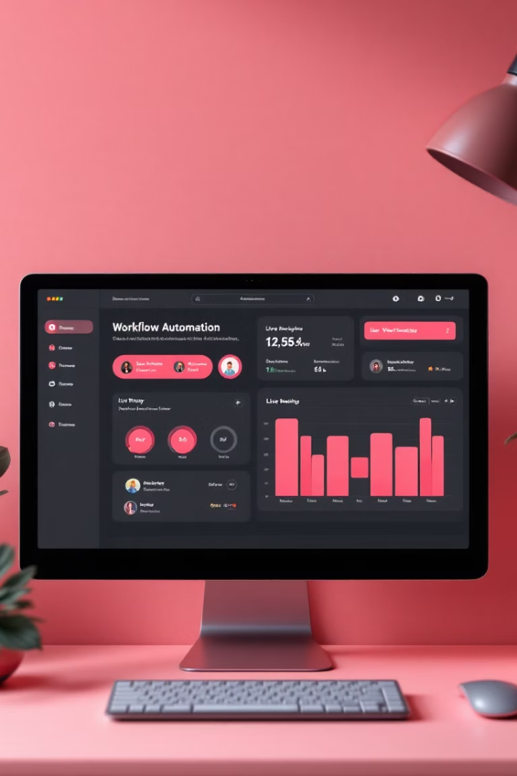



Demo: Amigo in Action
Easy Workflow Creation
Drag-and-drop simplifies setup.
Real-Time Monitoring
Track task progress instantly.
Key Feature Highlight
Seamless integrations and alerts.

Slide 8

Conclusion: Embrace the Future of Work
Amigo as a Partner
Your solution for scalable workflow automation.
Business Impact
Designed for companies of all sizes and sectors.
Call to Action
Schedule your personalized demo today.
Contact
Email: your.email@example.com | Phone: (123) 456-7890

